Slide 1
Machine Learning Melanoma Detection
Chris Rahal
Wei Wang
Brendan Golden
Nicolas Ortega

Slide 2
Table of contents
01
04
02
05
06
03
Introduction
App Development
Background & Statistics
Treatment Options
Methodology
Questions

Slide 3
01
Introduction

Slide 4
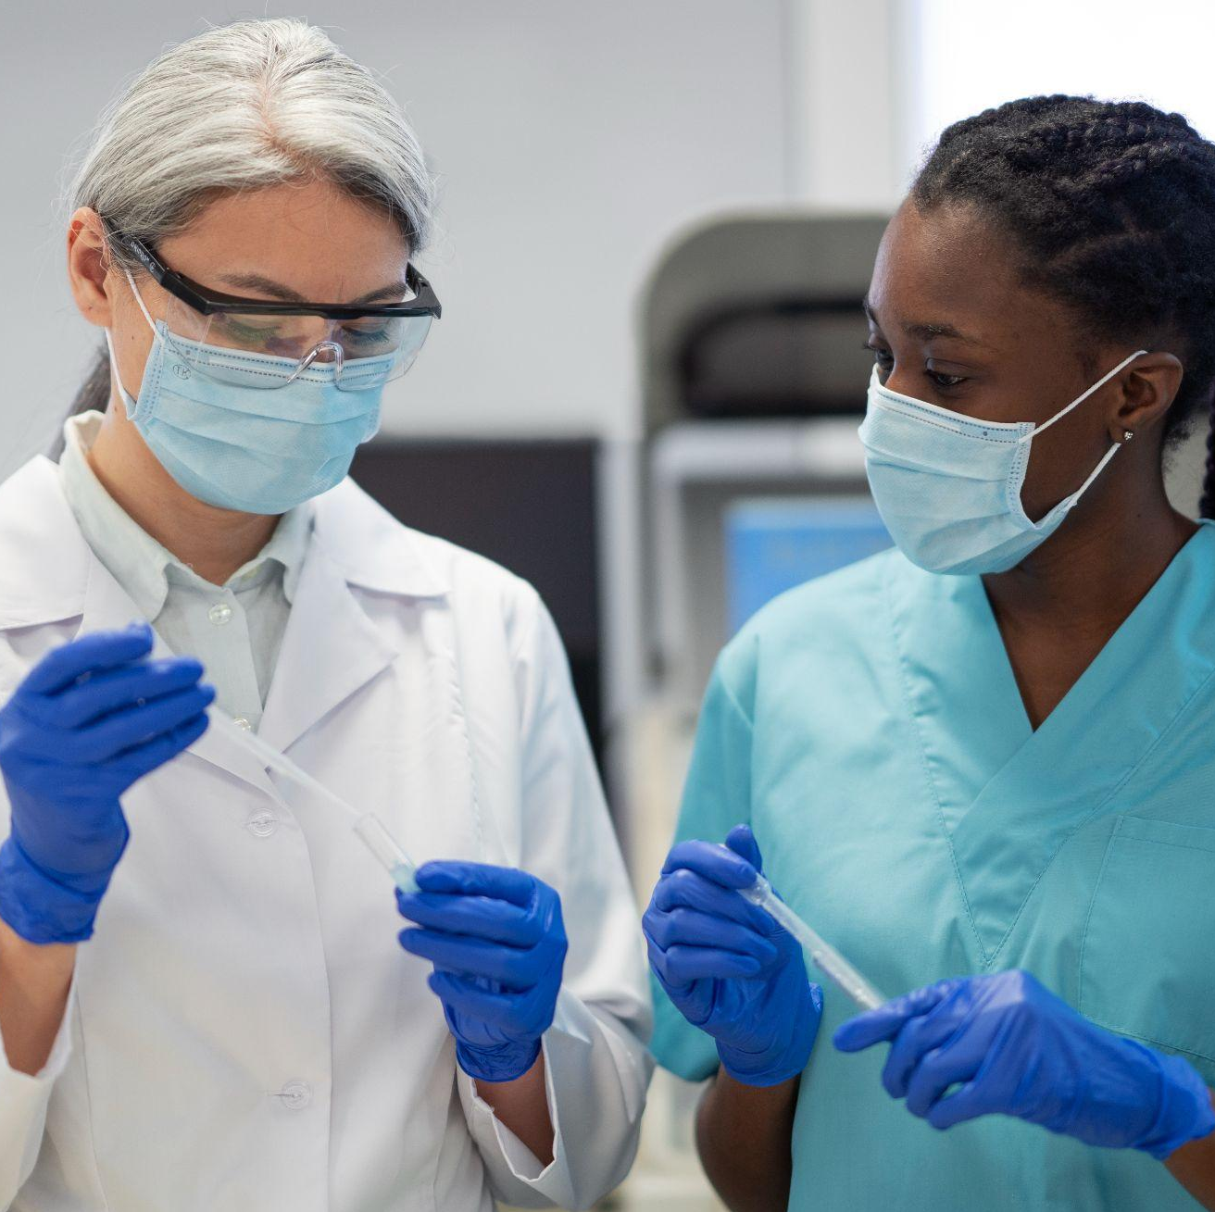
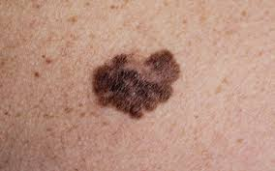
What is a skin melanoma?
Melanoma is a highly aggressive type of skin cancer characterized by rapid growth and early potential to spread to lymph nodes and distant organs.
Causes:
Unprotected or excessive UV exposure from the sun or indoor tanning.
Weakened immune system due to a medical condition or medications.
Having too many moles, where the more moles you have on your body the higher your risk for melanoma.
Source: https://www.skincancer.org/skin-cancer-information/melanoma/melanoma-causes-and-risk-factors/

Slide 5
02
Background & Statistics

Slide 6
Background
Diagnostic Limitations
Traditional diagnosis relies on experienced dermatologists however diagnostic results vary between doctors and there is resource scarcity depending on where the patient is in the country.
Current landscape
Our Solution
Early symptoms of melanoma are often difficult to detect with the naked eye thus patients end up seeking medical attention in the late stages of the disease.
Creating a machine learning model based on thousands of images of skin melanoma to detect which are benign or malignant and use a web page where patients can import their image for early on detection.

Slide 7
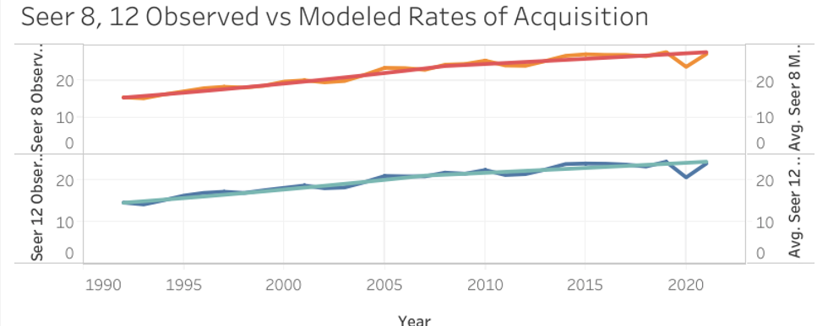
Data and Statistics
Relevant Statistics | Number
Average Seer 8 Acquisition | 18.62
Average Seer 12 Acquisition | 19.98
Average Death Rate | 2.52
Data Trends and Findings
It appears as if more individuals are contracting cancer as time progresses
Death seems to be decreasing, as the survival rate increases
Collective awareness about melanoma is at an all time high
Research and preventative methods are advancing exponentially
The Included Statistics are from the National Cancer Institute
All of the numbers are out of 100,000 individuals
Seer 8 and Seer 12 are the relevant data sets collected, Seer 8 began in 1975 and Seer 12 began in 1992
The death rate is calculated across the entire time period
Potential reasons for the increase in acquisition rate with subsequent decrease of mortality
Click on the Provided Link for more Information Regarding Cancer Statistics https://seer.cancer.gov/statfacts/html/melan.html

Slide 8
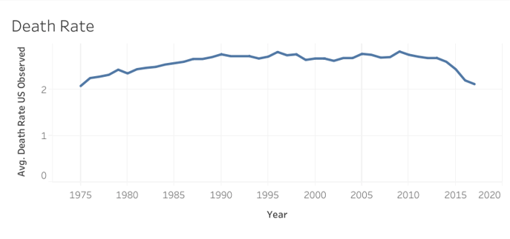
Death Rate over the Years

Slide 9
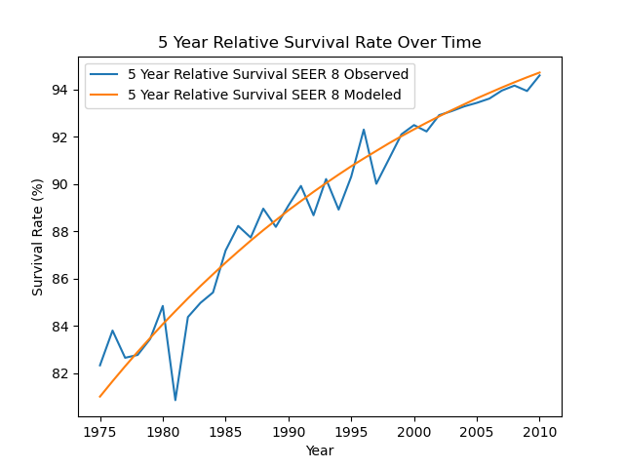
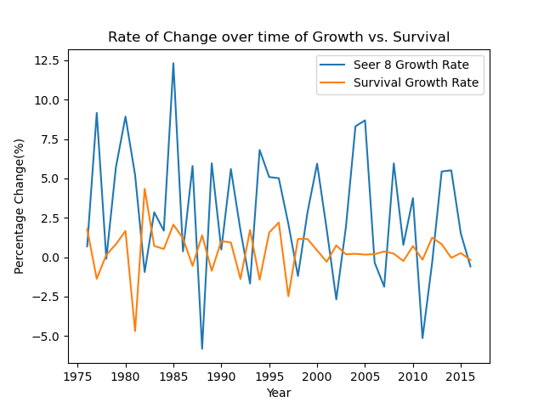
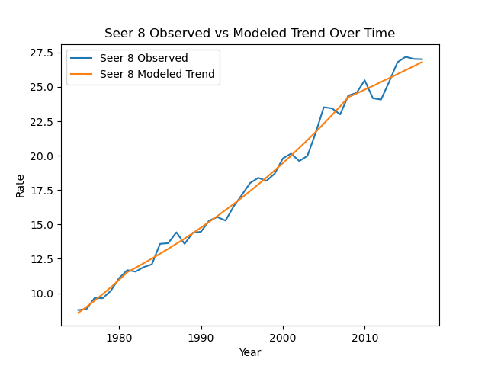
Relational Graphs
Observed vs Modeled Survival Rate
Rate of Change of Growth and Survival Rate
Seer 8 Observed vs Modeled

Slide 10
03
Methodology

Slide 11
10,000 images
1,000 images
91%
Trained our model
Tested our model
Accuracy, effectively distinguishing between benign and malignant skin lesions

Slide 12
Methodology
Project Design
Transform
Use convolution neural network machine learning model for our image based dataset. Our sample size was 10,000 images, half of the images were of benign melanomas and the other half were of malignant melanomas.
Normalization: Rescaled pixel values to a range of 0 to 1 for better model training.
Data Augmentation: Split the dataset into training, validation, and test sets.
Resizing: Adjusted images to 224x224 pixels to standardize input dimensions for the Convolutional Neural Network (CNN).
Extract
Load
Dataset Source: The data was extracted from Kaggle’s "Melanoma Skin Cancer Dataset of 10,000 Images".
Steps in Extraction:
Downloaded the dataset from Kaggle.
Explored and printed file paths to understand the directory structure.
Target: The processed data was fed into a custom-built CNN model for training and evaluation.
Steps in Loading:
The model was trained using the preprocessed data.
The trained model was saved for future predictions.

Slide 13
Model Creation
Data Preparation
Model Architecture
The dataset is loaded from the specified directories using `ImageDataGenerator` to preprocess images (normalizing pixel values).
The training data is split into training and validation sets using the `validation_split` parameter.
A simple Convolutional Neural Network (CNN) is created using Keras `Sequential` API.
The model includes:
Two convolutional layers (`Conv2D`) with ReLU activation and MaxPooling layers (`MaxPooling2D`) for downsampling.
A flattening layer (`Flatten`) to convert the 2D matrix into a 1D vector.
Dense layers (`Dense`) for fully connected layers, including an output layer with a sigmoid activation function for binary classification.
The model is compiled with the Adam optimizer, binary cross-entropy loss.

Slide 14
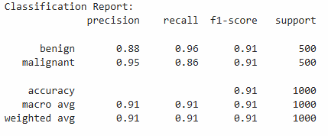
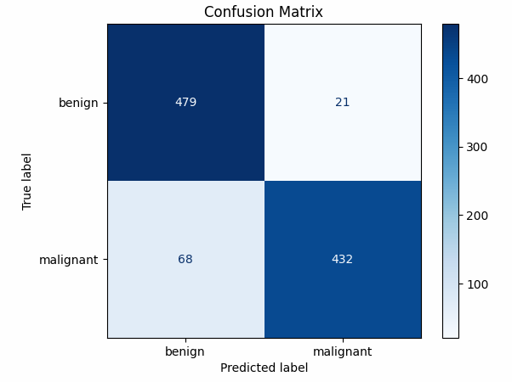
Model Report
Problem statement
Clearly state the specific problem or challenge in the medical field. Emphasize its significance and impact, highlighting gaps or limitations in current knowledge or approaches that motivate the need for a breakthrough
Implications and Problems
Strengths:
The overall accuracy of 91% is strong, demonstrating good classification performance.
High precision for malignant cases (95%) suggests the model rarely misclassified benign cases as malignant, reducing unnecessary concerns in diagnosis.
Weaknesses:
Recall for malignant cases (86%) is relatively lower, indicating the model may fail to detect some malignant cases. In a real-world scenario, this could lead to missed diagnoses, which is critical in cancer detection.

Slide 15
04
App Development

Slide 16
HTML Structure and Functionality
Webpage Structure:
Backend Prediction:
Left Sidebar: Displays melanoma prevention tips.
Main Content: Includes an image upload form, image preview, and prediction result.
Right Sidebar: Shows suggested actions based on the prediction and a disclaimer.
The image is sent to the backend using a `fetch()` POST request for prediction. Image is processed to app.py file and uses flask of H5 model to determine result of Melanoma
The backend returns the prediction (benign or malignant) and confidence level.
File Upload:
Result Handling:
Users upload an image of a skin lesion, and a preview is shown on the page
Displays prediction and confidence percentage

Slide 17
Suggested Actions Based on the Result of the Uploaded Image
Malignant:
Benign:
Consult a dermatologist immediately.
Avoid sun exposure and use sunscreen daily.
Prepare for diagnostic tests such as a biopsy.
Explore treatment options, including surgery, radiation, and immunotherapy.
Join a support group for melanoma patients and caregivers.
Monitor the lesion for changes in size, color, or shape.
Schedule regular skin checks with a dermatologist.
Use sunscreen to protect your skin.

Slide 18


Slide 19
05
Treatment Options

Slide 20
Malignant Melanoma Treatment options
Treatment option | Efficacy rate | Side effects | Cost | Availability
Surgery | 90% | High | $$$$ | Requires specialized facilities
Immunotherapy | 70% | Moderate | $$$$$ | Available in select medical centers
Targeted Therapy | 75% | Moderate | $$$$ | Available with advanced medical care
Radiation Therapy | 60% | Moderate | $$$ | Available in most hospitals
Chemotherapy | 50% | High | $$$ | Widely available but often a last resort
Clinical Trials | Variable | Mild to Severe | $$-$$$$ | Limited to research hospitals

Slide 21
Suggested Actions: Malignant Melanoma
Consult a Specialist:
Lifestyle Adjustments:
Schedule an appointment with a dermatologist or oncologist immediately
Avoid direct sun exposure and use high-SPF sunscreen daily.
Maintain a healthy diet and avoid tobacco to support recovery.
Diagnostic Tests:
Prepare for tests such as a biopsy, imaging, or blood work to assess the stage.
Follow-Up Care:
Regular checkups to monitor for recurrence.
Engage in physical therapy if required post-treatment.
Treatment Options:
Surgery to remove the tumor.
Immunotherapy, targeted therapy, or radiation based on the severity.
Consider enrolling in clinical trials for innovative treatments.

Slide 22
Benign Melanoma Treatment options
Treatment option | Efficacy rate | Side effects | Cost | Availability
Surgical Excision | 95% | Mild | $$$ | Widely available in dermatology clinics
Laser Therapy | 85% | Mild | $$$$$ | Available in select dermatology centers
Cryotherapy | 80% | Mild | $$ | Available in most dermatology clinics
Electrocautery | 75% | Mild to Moderate | $$$ | Available in specialized clinics
Topical Medications | 70% | Minimal | $$ | Widely available with prescription
Observation | Variable | None | $ | Recommended for non-problematic lesions

Slide 23
Suggested Actions: Benign Melanoma
Monitor Changes:
Schedule Checkups:
Regularly check for changes in size, color, shape, or texture
Visit a dermatologist annually or as recommended
Preventative Care:
Removal (if needed):
Use sunscreen with SPF 30 or higher.
Wear protective clothing and avoid excessive sun exposure.
Consider surgical removal for cosmetic reasons or if changes occur.
Opt for minimally invasive options like cryotherapy or laser treatment if advised.

Slide 24
Thanks
Do you have any questions?

